Slide 1

Introduction to Communication Skills Unit 1.3

Slide 2
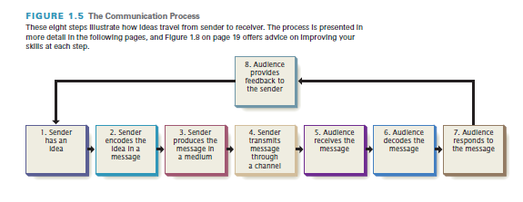
The Communication Process

Slide 3
The Communication Process
The sender has an idea.
The sender encodes the idea as a message.
The sender produces the message in a transmittable medium.
The sender transmits the message through a channel.
The audience receives the message.
The audience decodes the message.
The audience responds to the message.
The audience sends feedback.

